Slide 1




Slide 2
Day 15 (19/11): Multiple Joins
🎯 Objective
To learn how to join three or more tables and understand how complex relationships work in SQL.
🔍 Topics Covered
Joining three or more tables using different join types
Understanding complex relationships (one-to-many, many-to-many)
Using bridge/intermediate tables for multi-step joins
Avoiding duplicates and writing clean, efficient multi-table queries

Slide 3
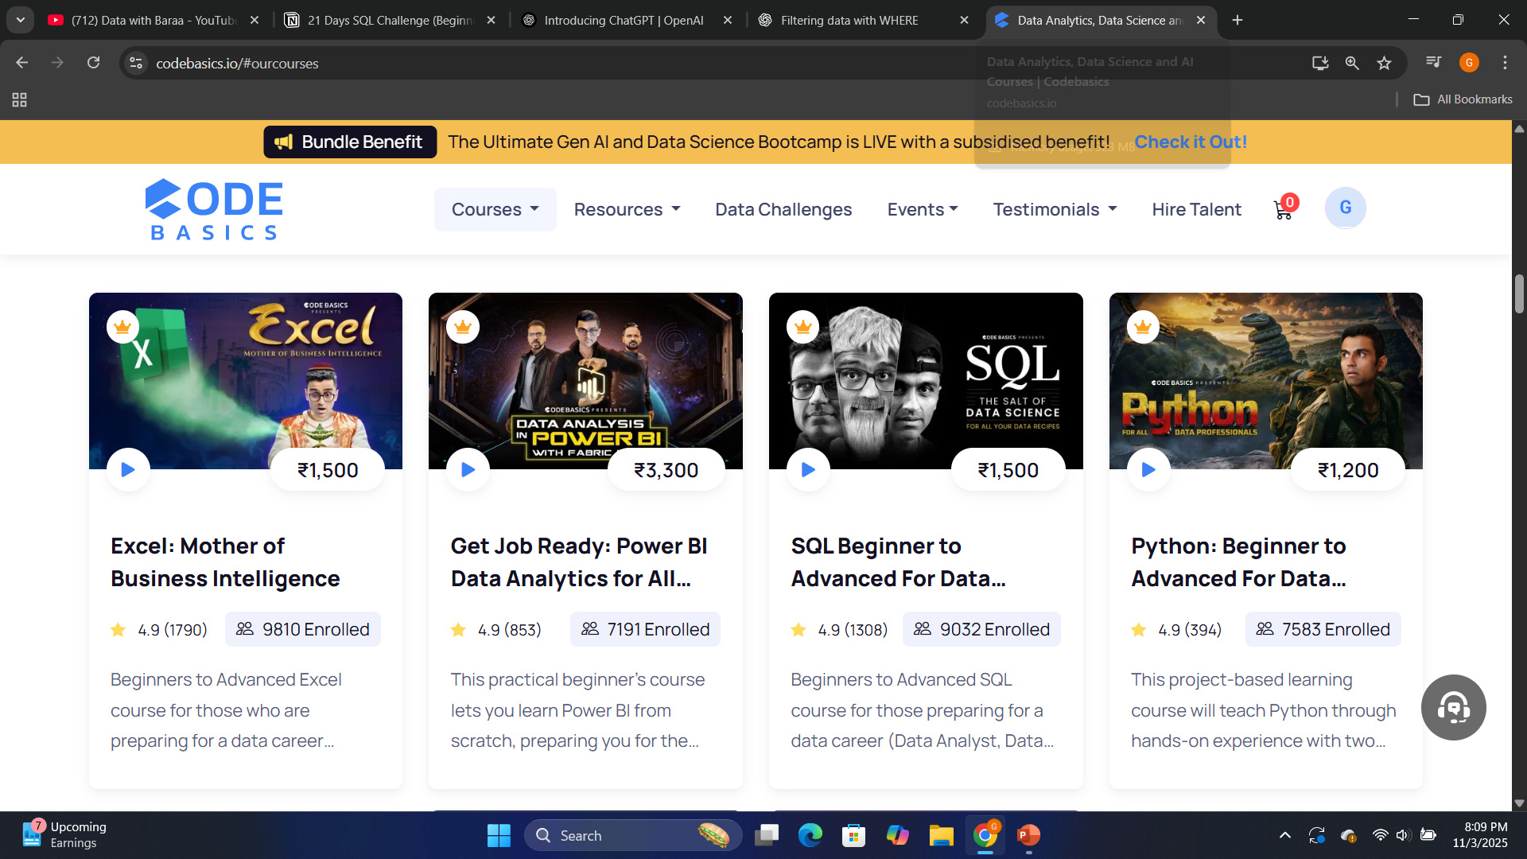
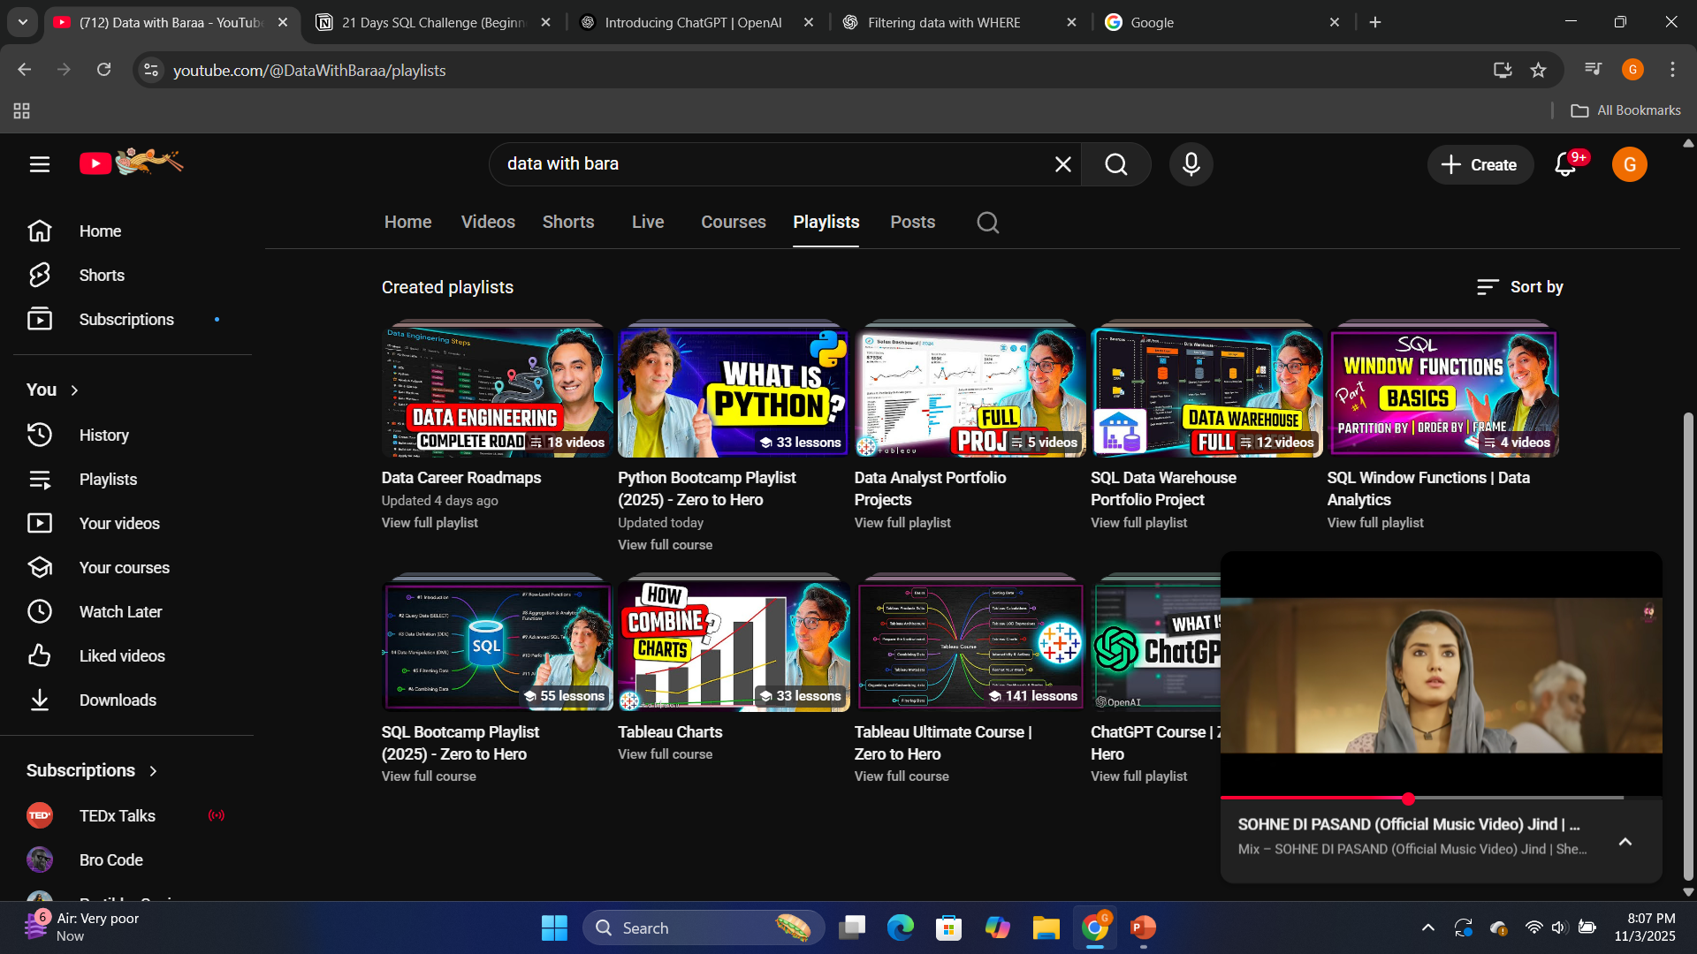
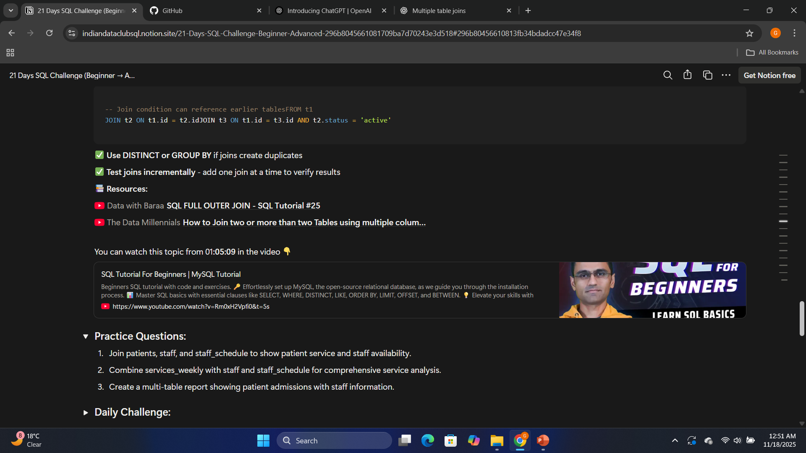
📚 Resources:

Slide 4
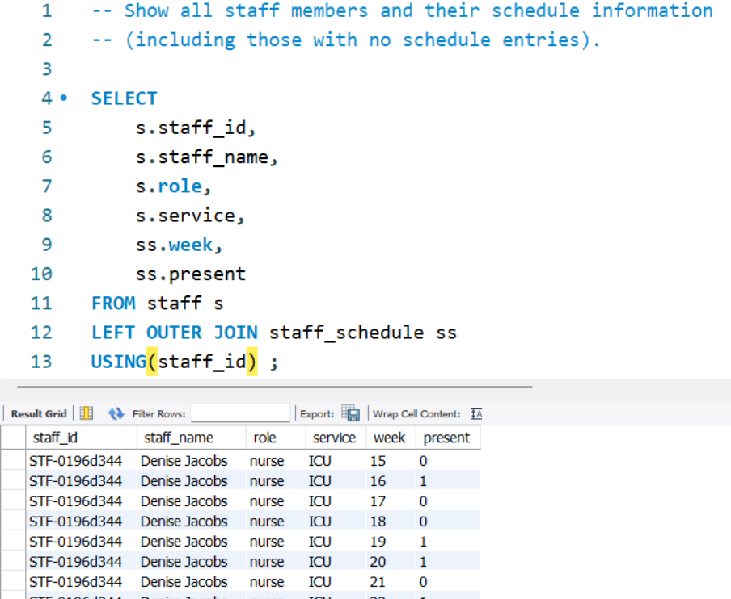
Practice Questions:
SELECT → retrieves selected columns from the joined tables.
FROM staff s → selects data from the staff table and assigns it the alias s.
LEFT OUTER JOIN staff_schedule ss → joins the staff_schedule table while keeping all staff members, even if they have no schedule.
USING(staff_id) → matches rows based on the same staff_id value in both tables, linking each staff member to their schedule records.

Slide 5
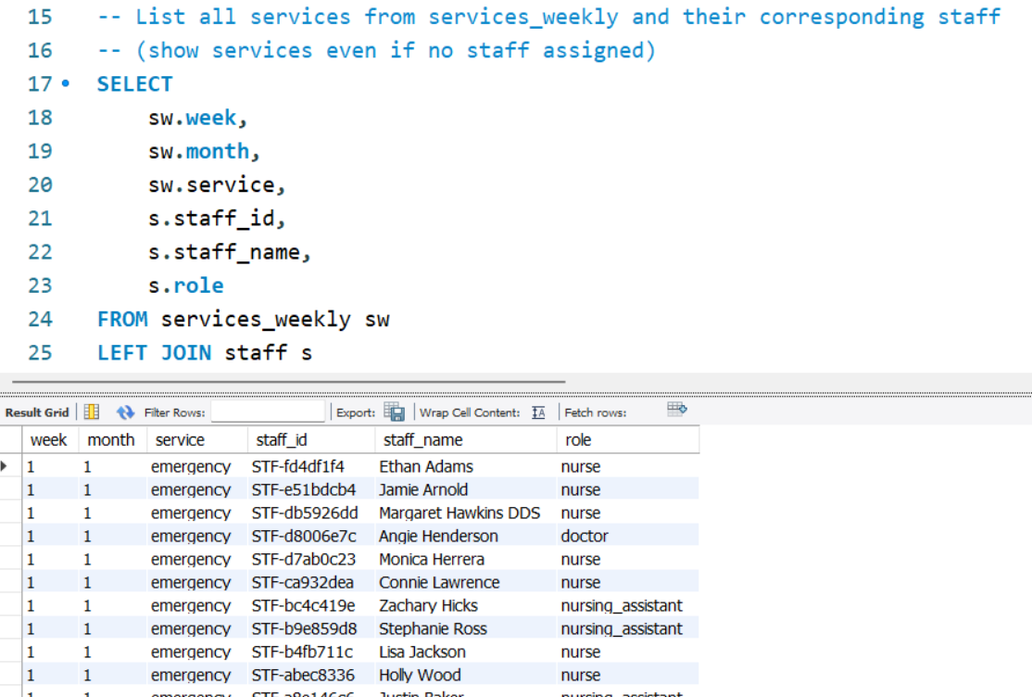
Practice Questions:
SELECT → retrieves the week, month, service, and related staff details.
FROM services_weekly sw → takes all services as the main table.
LEFT JOIN staff s → brings in staff information but keeps all services, even if no staff is assigned.
USING(service) → matches both tables based on the same service name.

Slide 6
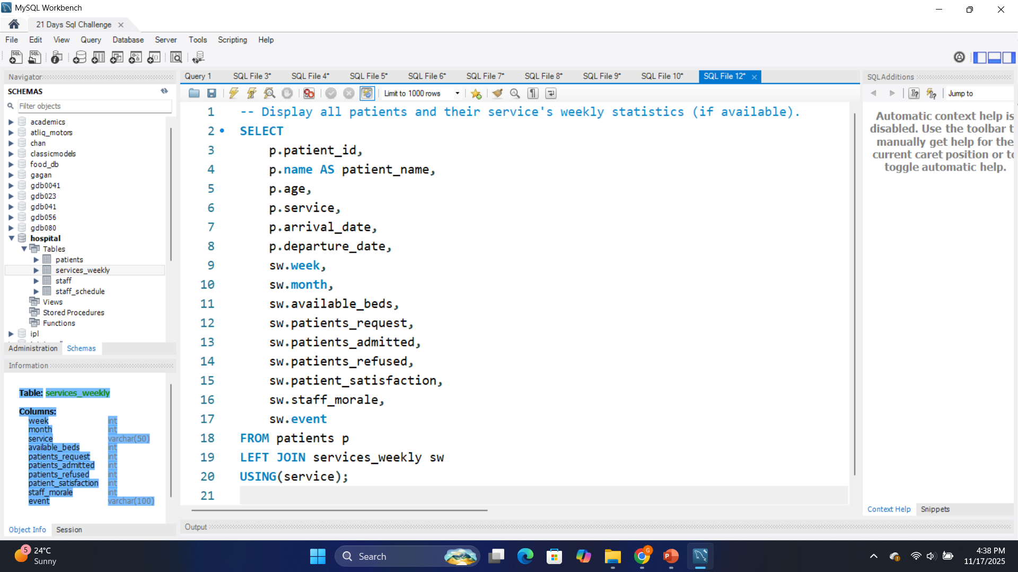
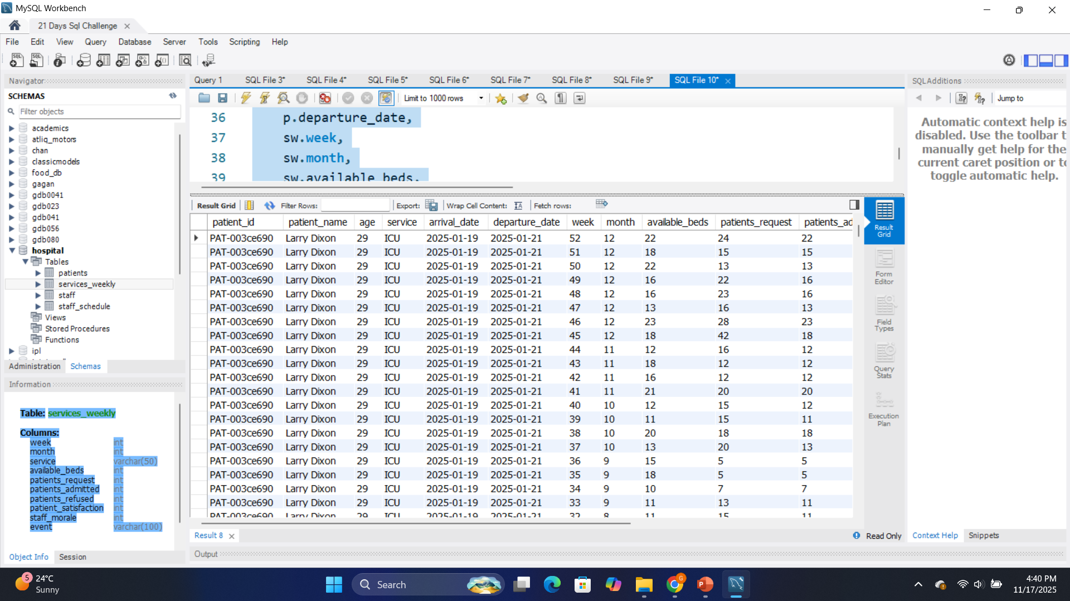
Practice Questions:
SELECT → retrieves patient info along with weekly service statistics.
FROM patients p → uses patients as the main table so all patients appear.
LEFT JOIN services_weekly sw → brings service statistics when they exist.
USING(service) → matches both tables by the common service name.

Slide 7
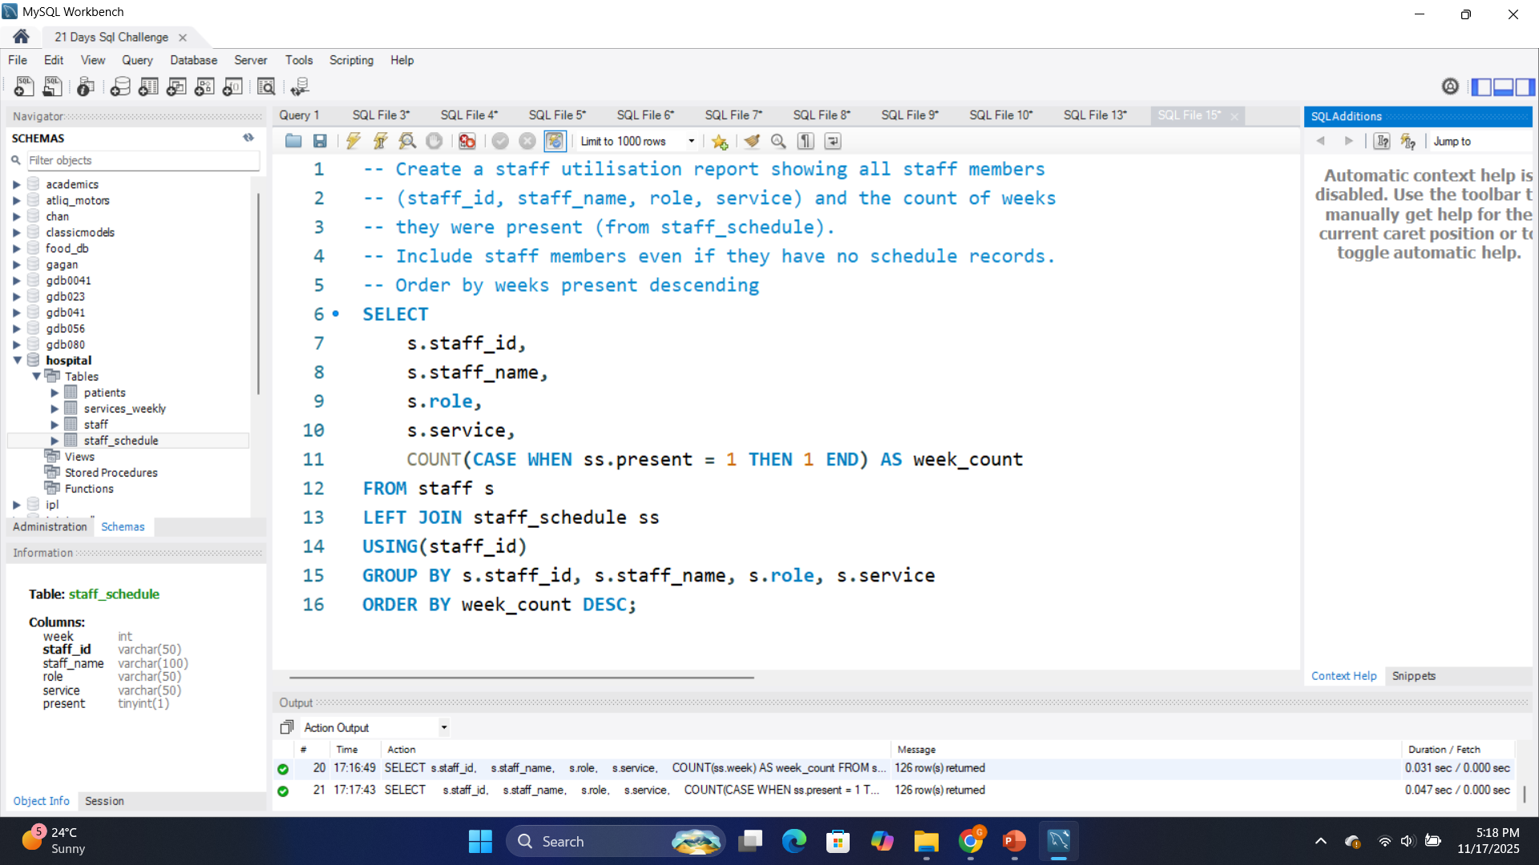
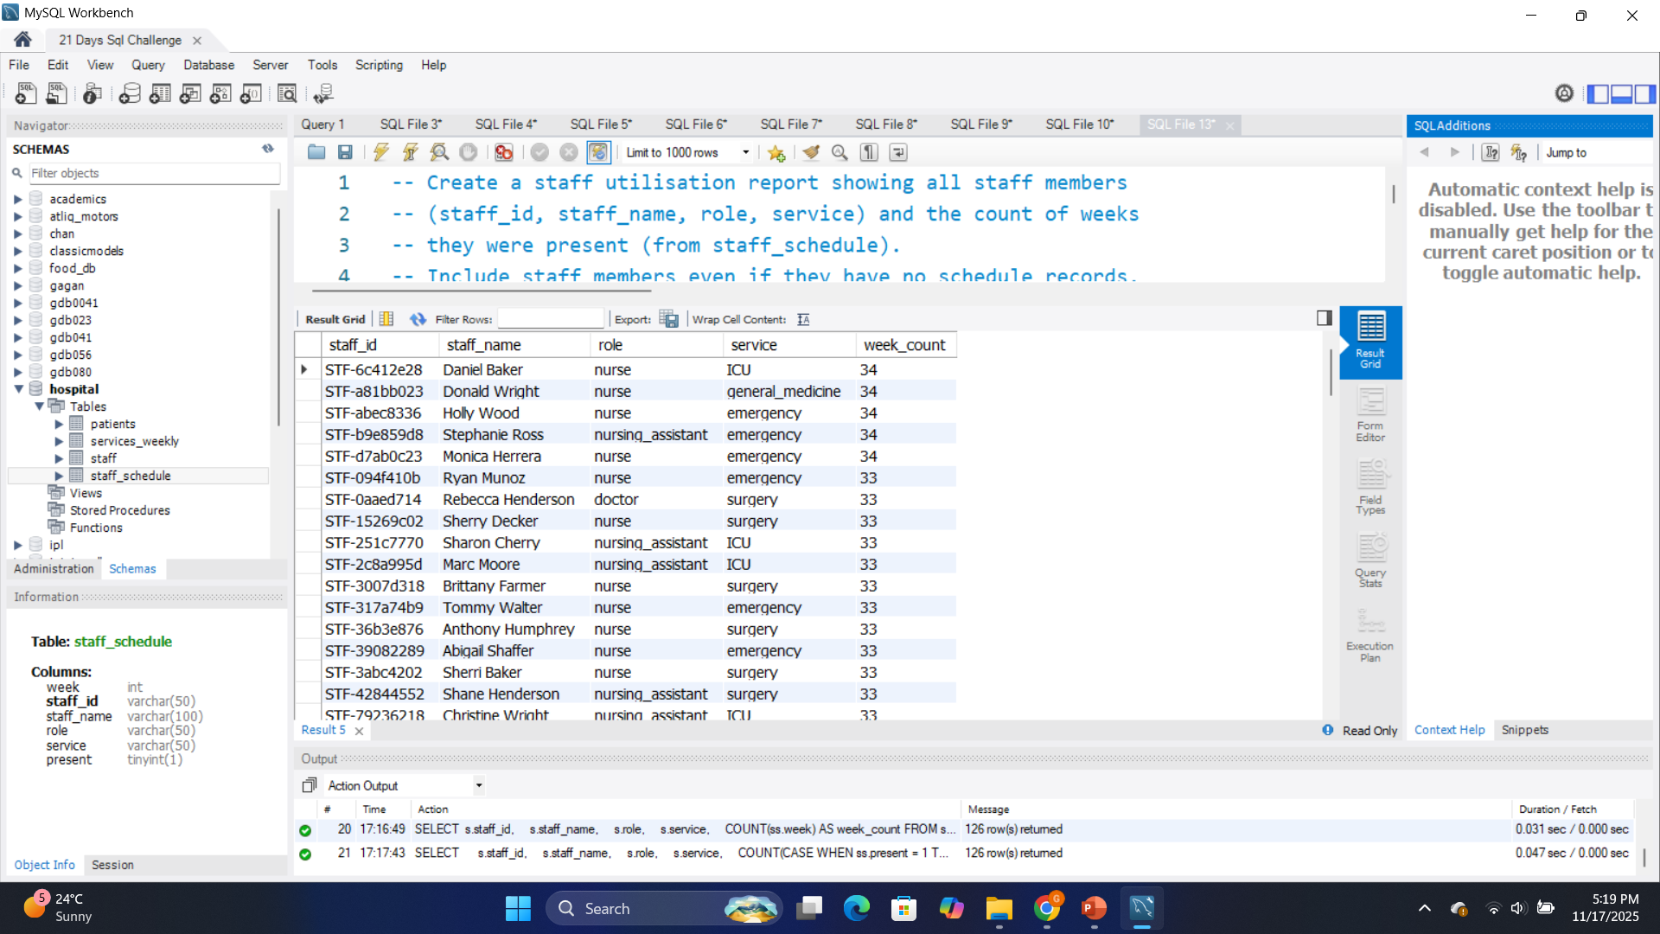
Daily Challenge:
SELECT → shows each staff member and how many weeks they were present.
FROM staff s → staff is the main table so all staff appear.
LEFT JOIN staff_schedule ss → adds schedule data but keeps staff with no records.
COUNT(CASE WHEN ss.present = 1 THEN 1 END) → counts only the weeks the staff was present.
GROUP BY → groups results by each staff member.
ORDER BY week_count DESC → sorts staff by highest to lowest presence.

